Slide 1
Service Architecture
µ

Slide 2

Who is broadcasting?
Eduards Sizovs
eduards.sizovs@gmail.com
www.linkedin.com/in/eduardsi
@eduardsi on Twitter

Slide 3
Agenda
Anatomy of a micro service
Micro service architecture by example
The Good Parts of the solution
Tooling
Q&A

Slide 4
Anatomy of a micro service

Slide 5

Micro services are tiny apps
talking via uniform interface
installed as well-behaved OS services.
Notes:
Who have heard about micro services?
Tiny: lightweight, small footprint, follow SRP
Uniform interface: RESTful. Decoupled, Scalable, Discoverable.
OS services: self-contained, run with a single one-liner: “jar – jar”, grab port & listen. No more arcane app servers. Use existing OS process management tool

Slide 6
java –jar micro-service.jar config.yml

Slide 7
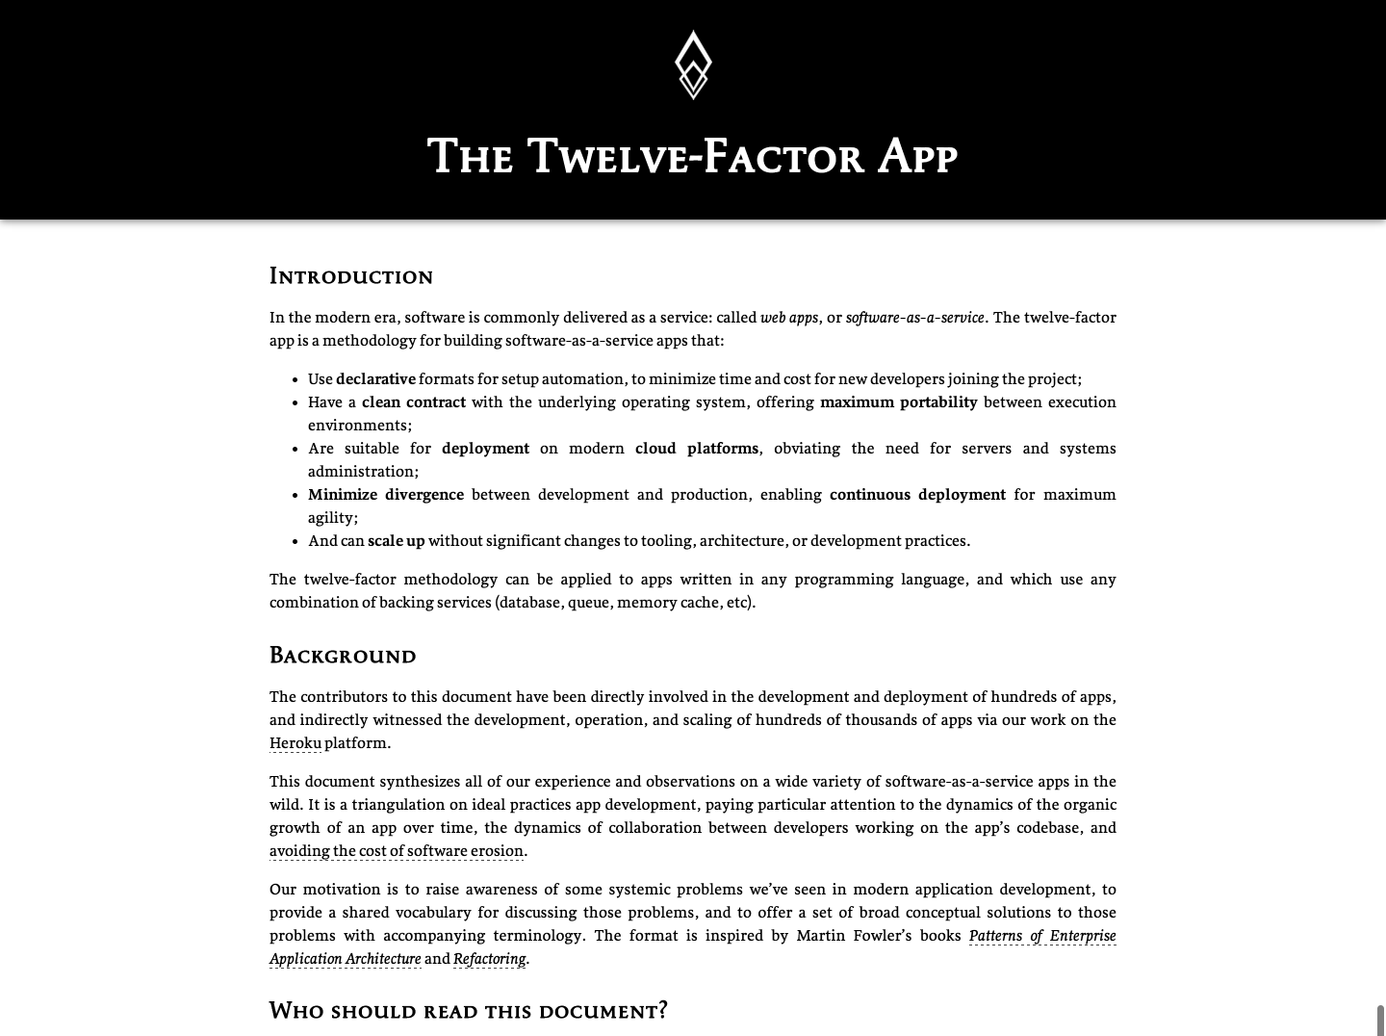
Notes:
A methodology for building software-as-a-service apps, comprises 12 rules you must learn after this presentation.
Says a lot about configuration, logging concurrency etc.

Slide 8

Traditional application vs. µ service based
Notes:
Evident differences:
A lot of moving parts working together to achieve app’s goal
Small
Simple internal structure
Micro-service is SOA application put to Nth (entieich) degree.

Slide 9
Micro service architecture by example
Notes:
Build Internal Loan Underwriting System based on “micro-service architecture” step by step.

Slide 10


Foundation for production
ready micro services
developed by
Dropwizard
Jetty
Jersey
Jackson
Metrics
Guava
Joda Time
Hibernate Validator
LiquiBase
YAML configuration
Graceful shutdown
Command-line API
Dropwizard on InfoQ → goo.gl/2RYALb

Slide 11
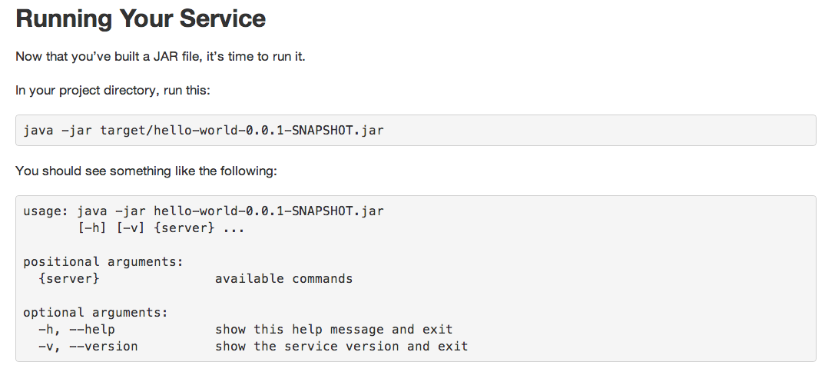
Command-line API?
unrecognized argument '--tpye'
Did you mean:
--type

Slide 12
Internal Loan Underwriting System
Requirement №1
Perform underwriting according to rules specified in DSL and store decisions in relational DB.
Notes:
Time to create the 1st micro service!

Slide 13

“…according to rules specified in DSL
DSL hero is…

Slide 14
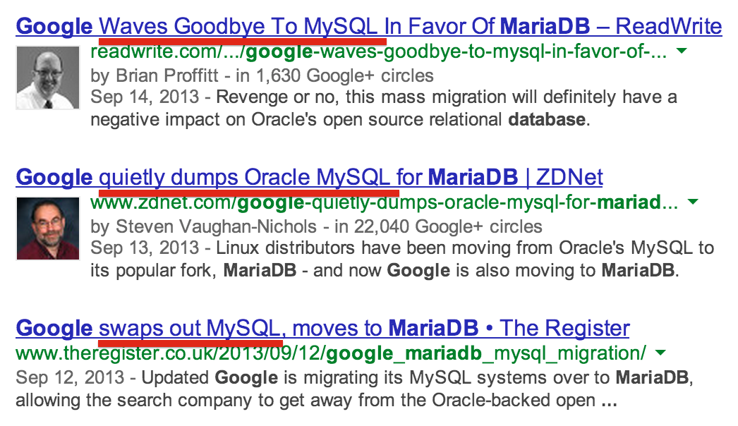

“…and store decisions in Relational DB
RDB hero is…

Slide 15



RESTful API / JSON
Underwriter
Relational DB

Slide 16
Internal Loan Underwriting System
Requirement №2
Fancy back-office application that allows users to perform underwriting and look over decisions.
Why separate micro service?
Back-office is a regular client. Many still to come.
Back-office is stateful
Back-office is server-centric, no JavaScript experience
Independent coding, testing & deployment

Slide 17

“…fancy back-office application
Fancy UI hero is…
…because it’s Java conference

Slide 18

Back-Office
Underwriter
Relational DB

Slide 19
Internal Loan Underwriting System
Requirement №3
Collect credit history from various 3rd party providers in parallel.
Why separate micro service?
SRP!
We have a team of Scala enthusiasts
Operations must self-heal in case of failure – Akka
Independent coding, testing & deployment

Slide 20


Back-Office
Credit History Collector
Underwriter
Relational DB

Slide 21
Internal Loan Underwriting System
Requirement №4
Project codename «CHNAPI» - API for our brand new partner «Chuck Norris».
Why separate micro service?
Public service must run in DMZ
Huge number of requests – queuing is a must
Underwriter is not ready to scale – other dev priorities
We don’t know what kind of architecture to apply yet
Notes:
Welcome CHNAPI Gateway:
Implements Chuck Norris API
Transforms external request to a format understood by Underwriter
Scales according to Chuck Norris needs

Slide 22

Underwriter & CHNAPI Gateway integration
?
CHNAPI
Gateway
Underwriter
Underwriter
HTTP
CHNAPI
Gateway
Push can cause overload
What if Underwriter is down?
Underwriter
CHNAPI
Gateway
More elements in chain
How well does it scale?
JMS
Underwriter
HTTP Polling
CHNAPI
Gateway
CHNAPI exposes Feed
Underwriter polls CHNAPI for updates
Notes:
How well does it scale: Eventually I’ll have to scale both JMS and CHNAPI gateway.

Slide 23




CHNAPI Gateway
DMZ
Load Balancer
CHNAPI
Gateway
Load Balancer
HTTP
Polling
Underwriter
CHNAPI
Gateway
CHNAPI
Gateway
JSON feed, OData or custom-crafted
Any JSON storage, e.g. MongoDB

Slide 24

Back-Office
Credit History Collector
Underwriter
CHNAPI
Gateway
Relational DB
MongoDB

Slide 25
Internal Loan Underwriting System
Requirement №5
Chuck Norris is interested in all underwriting decisions. Project codename «CHNORR».
Why separate micro service?
Daily reporting, during active working hours
External Client API with a tail of transitive dependencies
Neightbor dev team would like to use CHNORR!

Slide 26



CHNORR
DMZ
Load Balancer
CHNORR
Events
Underwriter
CHNORR
HTTP
CHNORR
Spring Batch
Any storage for keeping data in reporting-friendly format
Notes:
- Time to unlock our data and publish events so others can benefit. Remember about HTTP! Events goes though HTTP calls. WebHooks?
- Now we have a simple business processes span 1+ system.
Middleware/ESBs for Orchestration suck! Prefer choreography

Slide 27

Back-Office
MongoDB
Credit History Collector
Underwriter
CHNAPI
Gateway
CHNORR
Relational DB
MongoDB
Notes:
Challenges are defeated! For quite simple app we’ve built 5 independently deployable micro services.

Slide 28
The Good Parts of the solution

Slide 29

Toolset unchained
Architectural approaches
Polyglot
Storages
Frameworks
Notes:
Frameworks: No jar hell. Downgrade CXF example.
Summary:
Developers can experiment & leverage their skillset better
Less risk of failure (Disposable – rewrite over maintain)

Slide 30

Scalability
HTTP stack
Independent provisioning
Fine tuning
Elasticity
Notes:
HTTP stack: LB, Cache, Sec…
Independent provisioning: different set of servers per micro service
Fine tuning: understand performance in isolation. Fine-tune VM, JVM
Elasticity: auto-scale (run one more instance) based on TX exec time, queue depth.

Slide 31

Independence
Development
Testing
Deployment
Notes:
Development:
Scale dev: less conflict. Work streams: skill, location, risk, preference. Applications can evolve in different pace.
Responsibilities: whose pager should ring
Deployment: no big-bang, less risk, rollbacks (re-spawn attempt), fast startup (crazy idea of app+config)

Slide 32
How to deploy in a proper order?
Supply Dependency Descriptor with each micro service. For example:
depend.yaml for foo-service
dependencies:
group: com.microservices
artifact: bar-service
version: 2.x.x
-

Slide 33
How to deploy in a proper order?
We can forbid deployment in the wrong order by validating dependencies on Pipeline
bar-service
Test
Prod
bar-service
Test
Prod
2.0.0
1.9.0
foo-service
foo-service
1.0.0
1.0.0

Slide 34

How to develop?
Together with Dependency Descriptor (DD), put Vagrant file with DD-fed provisioner in a root source directory.
depend.yaml
Vagrantfile
up
Launch app with test doubles in place of real dependencies

Slide 35
How to test?
For every dependency create a test double
Production
Testing
Foo
Foo-TD
App
HTTP
App
HTTP
Bar
Qux
Bar-TD
Never mock internals. Mock externals instead.

Slide 36
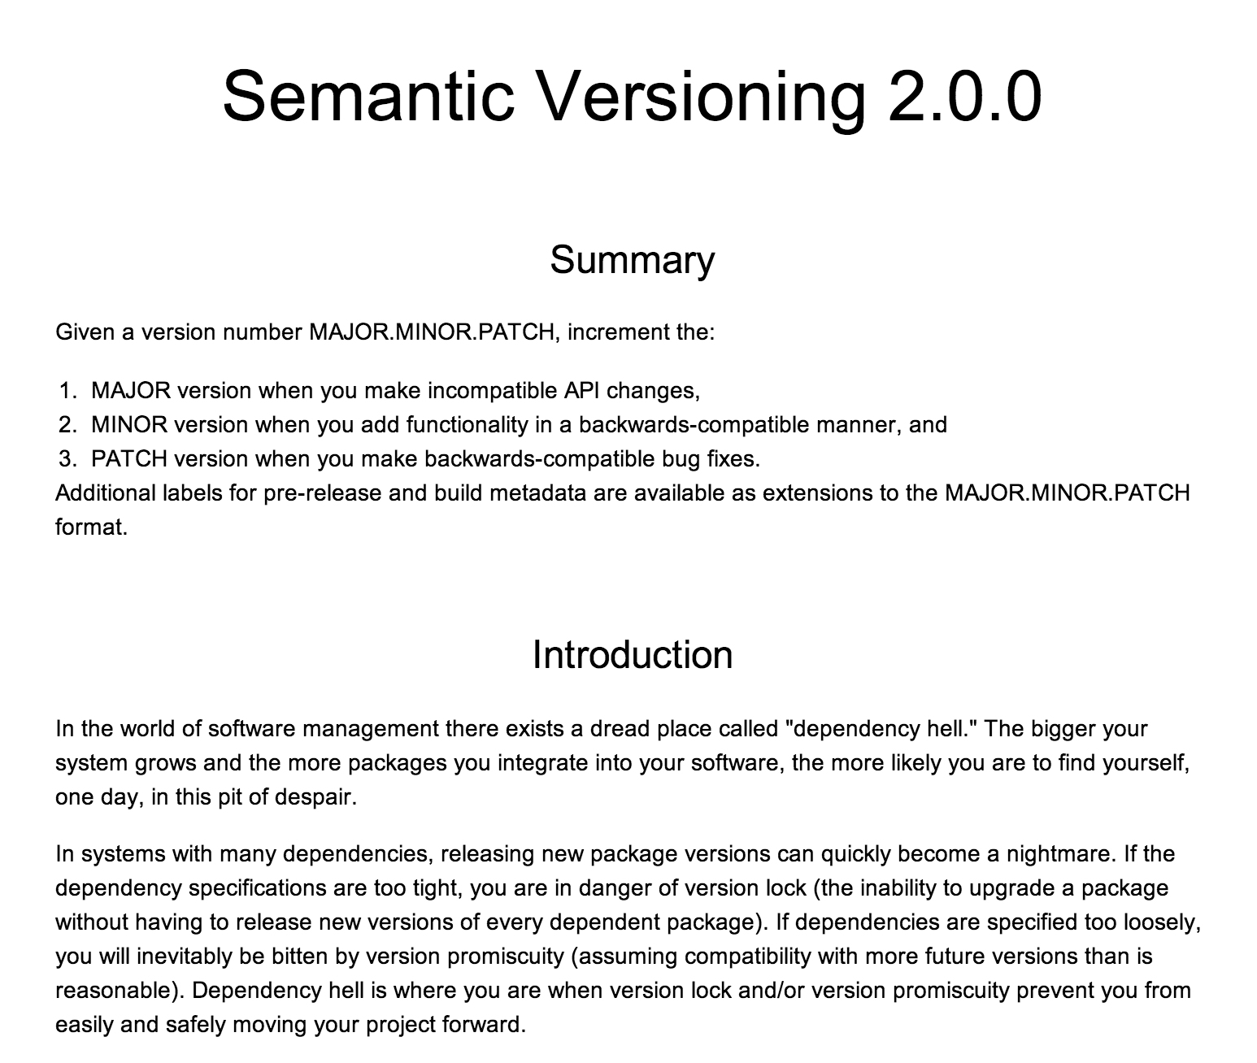

Slide 37
Tooling

Slide 38
Testing & Live Doc →
MOCO for test double creation
REST-assured for testing REST APIs
Cucumber for describing API usage with examples
Relish for publishing Cucumbers online

Slide 39
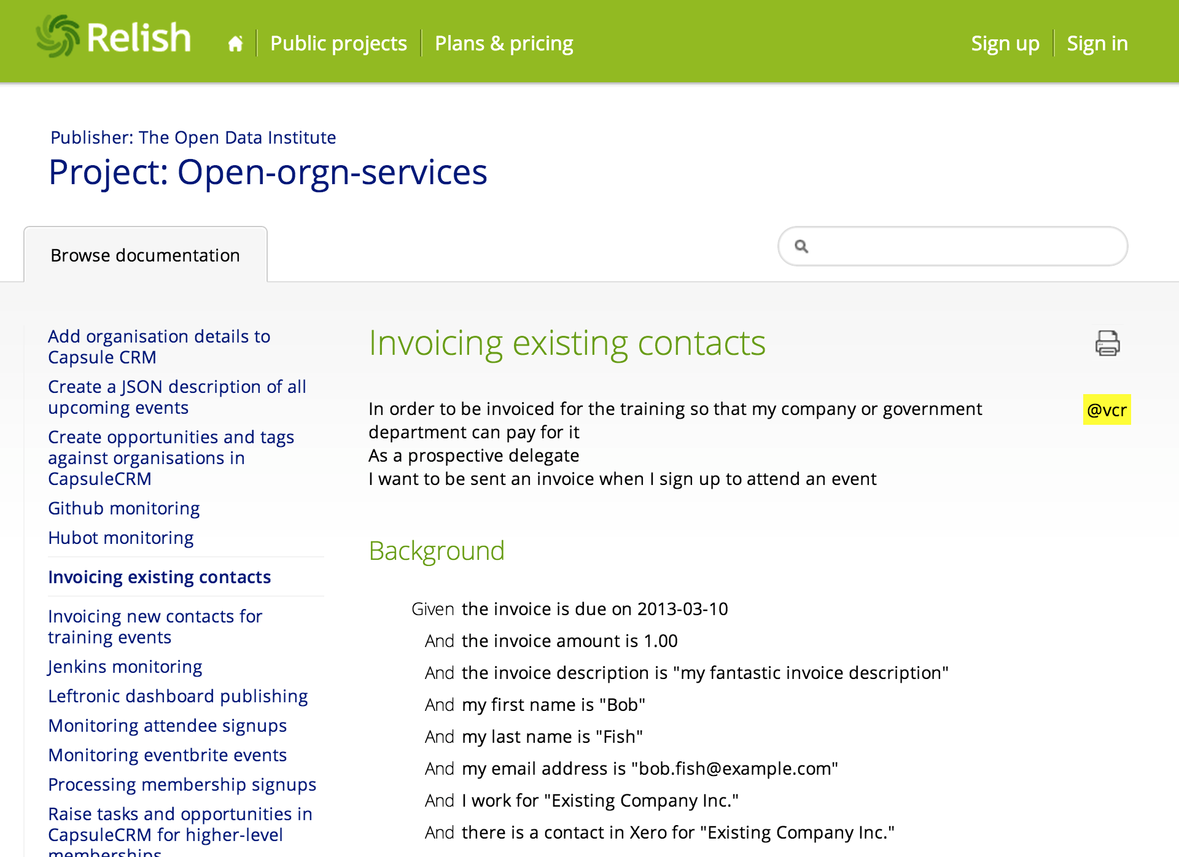

Slide 40

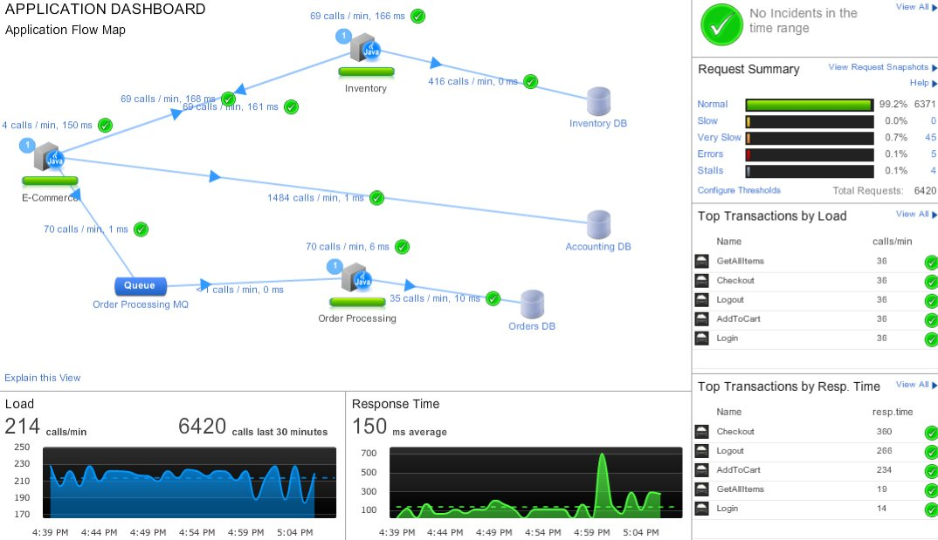
Notes:
AppDynamics - Usually workflow involves plenty of services. Woods instead of trees. Visualize TX flow, bottlenecks etc.

Slide 41


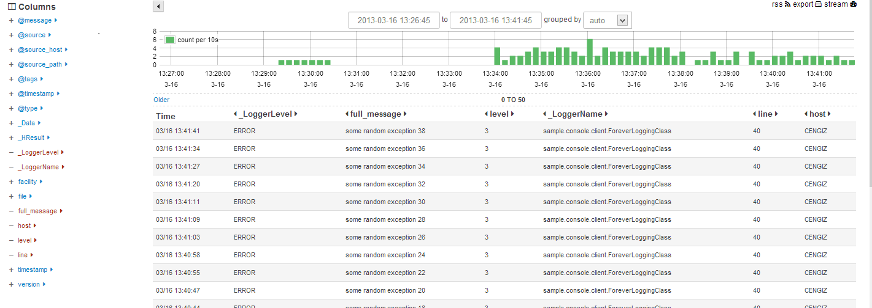

Slide 42

A shipping container system for your apps
VM without an overhead of VM
Docker on InfoQ → http://goo.gl/ALnjYt
Why Docker? Why Not Chef? → goo.gl/iJ8Idl

Slide 43


Learn more →
Micro Services by James Lewis → goo.gl/PS7BYK
Micro Services by Fred George → goo.gl/dgd8Ya

Slide 44

http://goo.gl/khddl

Slide 45
Conclusion

Slide 46
The Unix Philosophy
http://www.faqs.org/docs/artu/ch01s06.html
The next morning, "we had this orgy of `one liners.' Everybody had a one liner. Look at this, look at that. ...Everybody started putting forth the UNIX philosophy. Write programs that do one thing and do it well. Write programs to work together. Write programs that handle text streams, because that is a universal interface." Those ideas which add up to the tool approach, were there in some unformed way before pipes, but they really came together afterwards. Pipes became the catalyst for this UNIX philosophy. "The tool thing has turned out to be actually successful. With pipes, many programs could work together, and they could work together at a distance."
The next morning, "we had this orgy of `one liners.' Everybody had a one liner. Look at this, look at that. ...Everybody started putting forth the UNIX philosophy. Write programs that do one thing and do it well. Write programs to work together. Write programs that handle text streams, because that is a universal interface." Those ideas which add up to the tool approach, were there in some unformed way before pipes, but they really came together afterwards. Pipes became the catalyst for this UNIX philosophy. "The tool thing has turned out to be actually successful. With pipes, many programs could work together, and they could work together at a distance."
The next morning, "we had this orgy of `one liners.' Everybody had a one liner. Look at this, look at that. ...Everybody started putting forth the UNIX philosophy. Write programs that do one thing and do it well. Write programs to work together. Write programs that handle text streams, because that is a universal interface." Those ideas which add up to the tool approach, were there in some unformed way before pipes, but they really came together afterwards. Pipes became the catalyst for this UNIX philosophy. "The tool thing has turned out to be actually successful. With pipes, many programs could work together, and they could work together at a distance."
The next morning, "we had this orgy of `one liners.' Everybody had a one liner. Look at this, look at that. ...Everybody started putting forth the UNIX philosophy. Write programs that do one thing and do it well. Write programs to work together. Write programs that handle text streams, because that is a universal interface." Those ideas which add up to the tool approach, were there in some unformed way before pipes, but they really came together afterwards. Pipes became the catalyst for this UNIX philosophy. "The tool thing has turned out to be actually successful. With pipes, many programs could work together, and they could work together at a distance."
The next morning, "we had this orgy of `one liners.' Everybody had a one liner. Look at this, look at that. ...Everybody started putting forth the UNIX philosophy. Write programs that do one thing and do it well. Write programs to work together. Write programs that handle text streams, because that is a universal interface." Those ideas which add up to the tool approach, were there in some unformed way before pipes, but they really came together afterwards. Pipes became the catalyst for this UNIX philosophy. "The tool thing has turned out to be actually successful. With pipes, many programs could work together, and they could work together at a distance."
Notes:
Taking this philosophy and applying it to a SOA architecture would imply building services that focus on a single piece of functionality and communicate with other services to provide business value. Worth giving a try.

Slide 47
THANK YOU!

